Slide 1
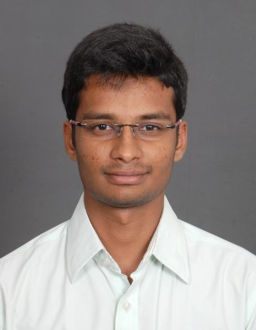
Rajeshwaran P J – Web Developer (.Net)
Education / Certifications
Bachelor of Engineering – Electrical and Electronics, Tamil Nadu, India.
Web Developer (.Net)
Years Experience: 1 Year
Areas of Expertise
Web Development using C#.NET
Have working experience in agile project development
Have good experience on SQL Server
Have good experience in Angular JS and Entity Framework
Have basic knowledge on Microsoft Azure
Previous Client
Microsoft, USA
Industry Sectors
Technology
Platform / Back-end developer
C# language, .NET framework, Visual Studio and tools
ASP.NET and web development
SQL Server
Entity Framework
LINQ
Knowledge of Azure technologies : table storage, blob storage, resource management
Previous working experience with Microsoft is an advantage
Overall industry experience: 1 year
Experienced in agile project development
UI developer
C# language, .NET framework, Visual Studio and tools
ASP.NET and web development
UI web development (HTML/Java script/CSS/AngularJS/Bootstrap)
Previous working experience with Microsoft is an advantage
Overall industry experience: 1 year
Experienced in agile project development
Responsibilities in current project
User story analysis, Task preparation, Implementation of user story, Code reviews, Writing Unit Tests, Attending daily scrum calls, Presenting work in front of customer

